Slide 1
Digital Portfolio
STUDENT NAME: SHARMILA.S
REGISTER NO AND NMID: CD554E7CC509C5BA08F4A7B71
DEPARTMENT: BSC.COMPUTER SCIENCE
COLLEGE: COLLEGE/ UNIVERSITY: TIRUPPUR KUMARAN COLLEGE FOR WOMEN/BHARATHIYAR UNIVERSITY

Slide 2
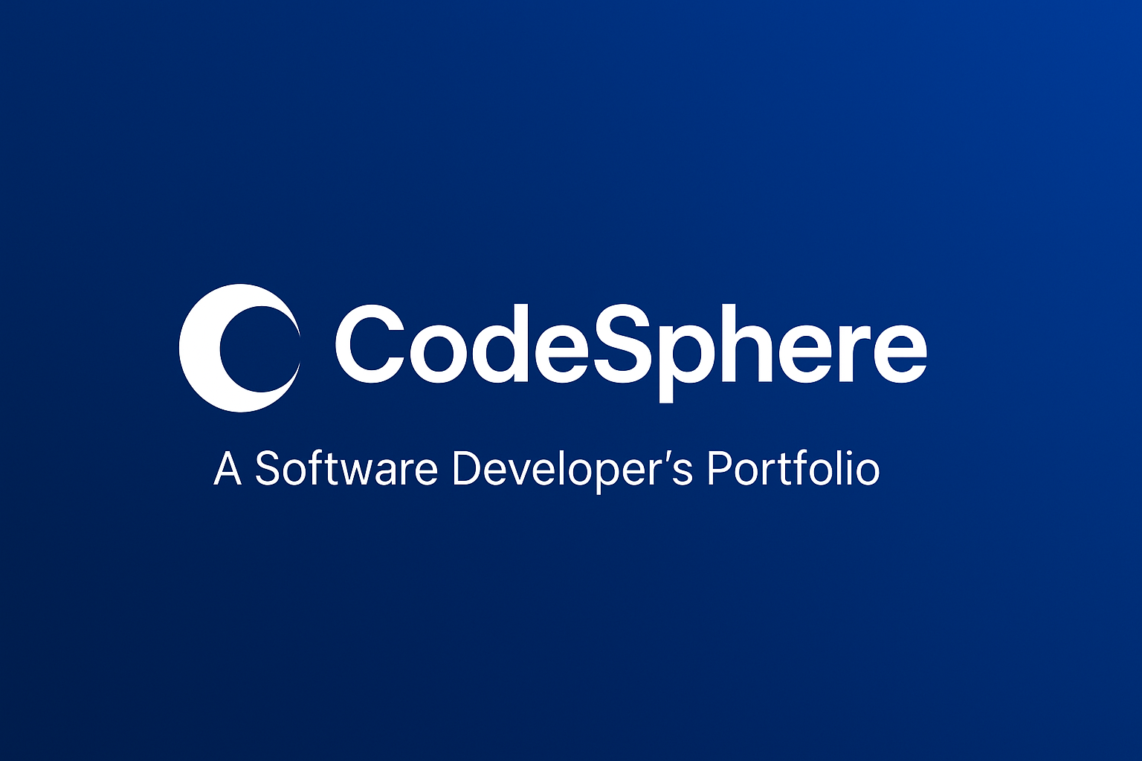
PROJECT TITLE

Slide 3


AGENDA
Problem Statement
Project Overview
End Users
Tools and Technologies
Portfolio design and Layout
Features and Functionality
Results and Screenshots
Conclusion
Github Link
3/21/2024 Annual Review

Slide 4

PROBLEM STATEMENT
Mobile software developers often struggle to effectively showcase their technical skills and project experience through traditional resumes or documents. These formats lack interactivity and do not demonstrate practical abilities in real-world app development. Recruiters and clients, on the other hand, require a modern, professional, and user-friendly platform to assess a developer’s expertise. Without a portfolio, opportunities for jobs, internships, and collaborations may be missed.

Slide 5

PROJECT OVERVIEW
This project is a personal portfolio website built with HTML, CSS, and JavaScript to showcase a mobile software developer’s skills and projects. It includes sections like introduction, about, projects, and contact, with a responsive layout and smooth navigation. The portfolio serves as a professional platform for recruiters, clients, and collaborators to explore the developer’s expertise in mobile app development.

Slide 6

WHO ARE THE END USERS?
The end users of this portfolio website are: Recruiters & Hiring Managers – to evaluate the developer’s skills for job roles. Clients – who may need mobile app development services. Peers & Collaborators – for networking and partnerships in tech. General Audience – anyone interested in exploring the developer’s projects and expertise.

Slide 7

TOOLS AND TECHNIQUES
HTML5 – for structuring the portfolio website. CSS3 – for styling, layout, and responsive design. JavaScript – for interactivity and smooth scrolling. Version Control (Git/GitHub) – to manage and host the project. Design Principles – clean layout, user-friendly navigation, and responsive UI.

Slide 8
POTFOLIO DESIGN AND LAYOUT
Header & Navigation Bar – simple menu for Home, About, Projects, and Contact. Hero Section – introduces the developer with name, role, and call-to-action. About Section – short bio with skills and expertise. Projects Section – showcases apps with images, descriptions, and links. Contact Section – provides email, LinkedIn, and GitHub for easy reach. Footer – includes copyright and closing note. Responsive Layout – adapts to mobile, tablet, and desktop screens.
8

Slide 9
FEATURES AND FUNCTIONALITY
The portfolio offers smooth navigation with a responsive design that works on all devices. It highlights the developer in the hero section, showcases projects with descriptions, images, and links, and provides easy access to contact details like email, LinkedIn, and GitHub. Interactive features such as smooth scrolling and clickable buttons enhance the user experience, while the modern layout ensures a professional and appealing look.

Slide 10
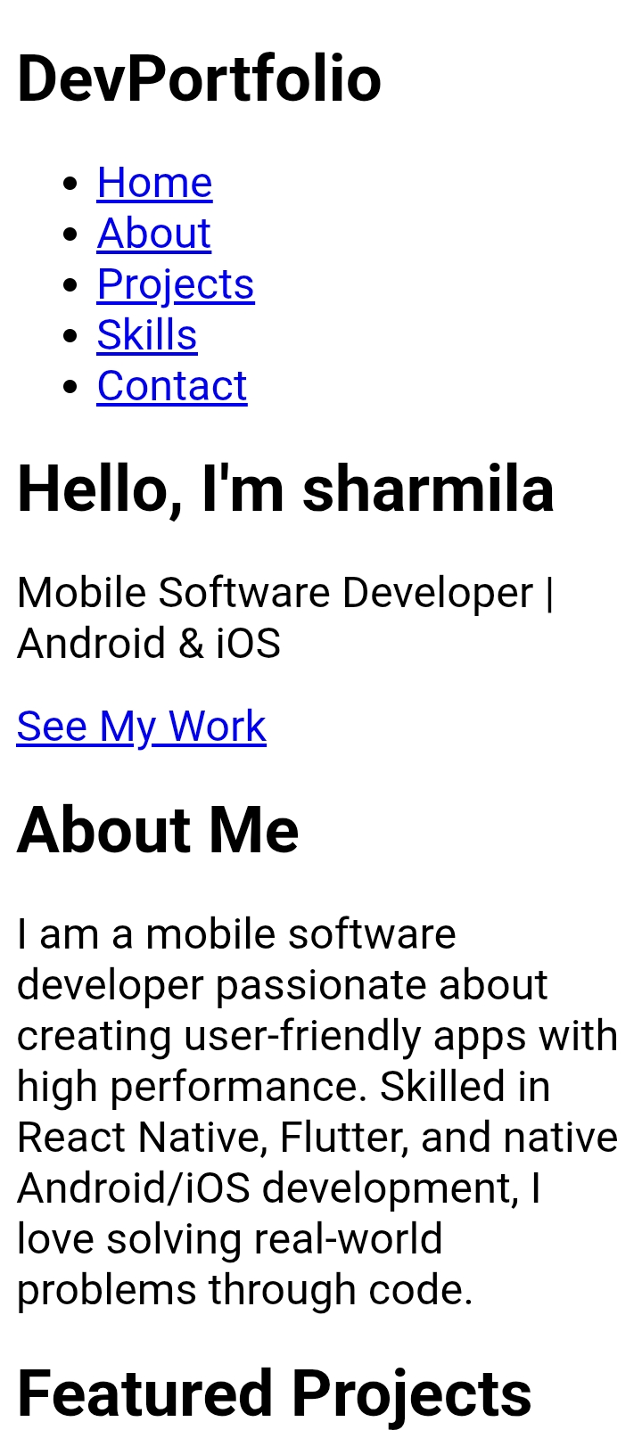
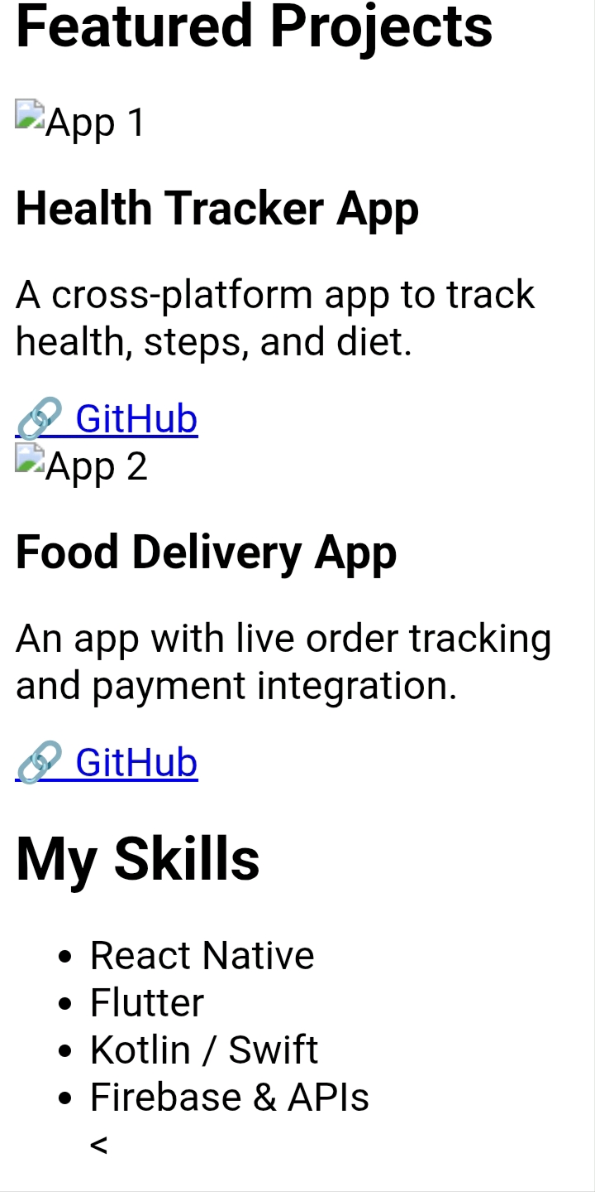

RESULTS AND SCREENSHOTS
3/21/2024 Annual Review
10

Slide 11
CONCLUSION
The portfolio successfully highlights the skills and projects of a mobile software developer in a professional and user-friendly way. By combining HTML, CSS, and JavaScript, it ensures responsive design, smooth navigation, and interactive features. It serves as a digital identity that helps recruiters, clients, and peers easily explore the developer’s expertise, making it an effective tool for career growth and opportunities.
11

